Slide 1
ICIP Review
Presenter: Kim Seung Hwan (overnap@khu.ac.kr)

Slide 2
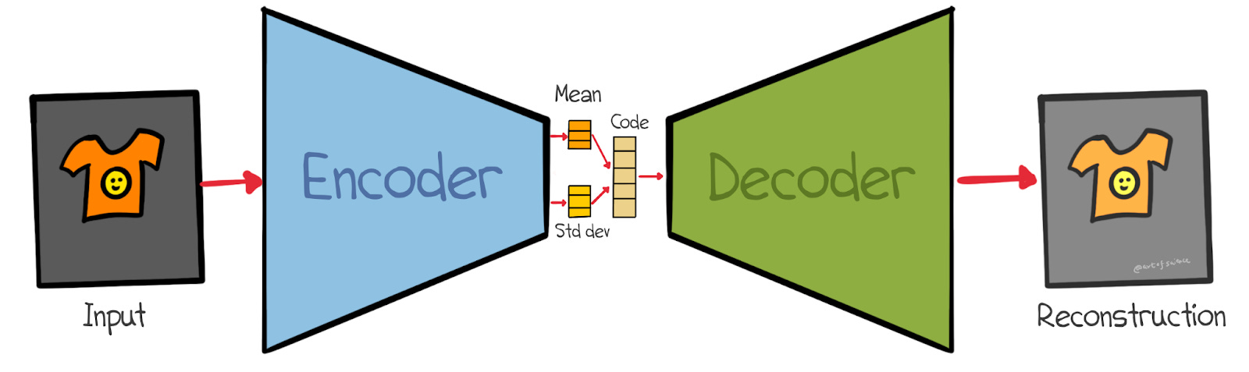

Variational Autoencoder
Similar to autoencoder, but probability-based
Encoder $q_{φ}(z|x)$
Decoder $p_{θ}(x|z)$

Slide 3
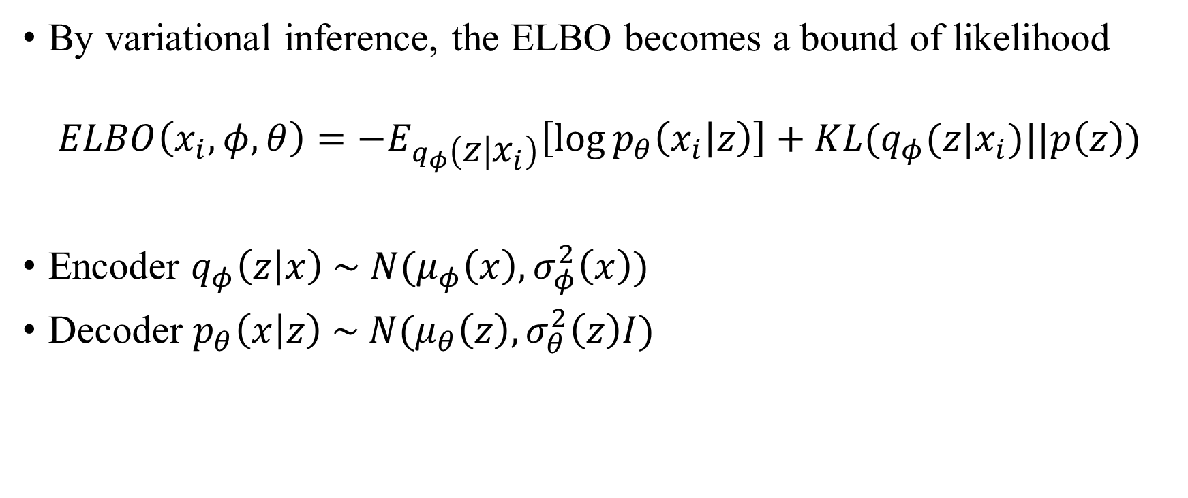
Gaussian Variational Autoencoder
By variational inference, the ELBO becomes a bound of likelihood
$$ELBO\left(x_{i},φ,θ\right)=−E_{q_{φ}\left(z | x_{i}\right)}\left[\log{p_{θ}\left(x_{i} | z\right)}\right]+KL(q_{φ}(z|x_{i})||p\left(z\right))$$
Encoder $q_{φ}\left(z | x\right) \sim N(μ_{φ}\left(x\right),σ_{φ}^{2}\left(x\right))$
Decoder $p_{θ}\left(x | z\right) \sim N(μ_{θ}\left(z\right),σ_{θ}^{2}\left(z\right)I)$

Slide 4
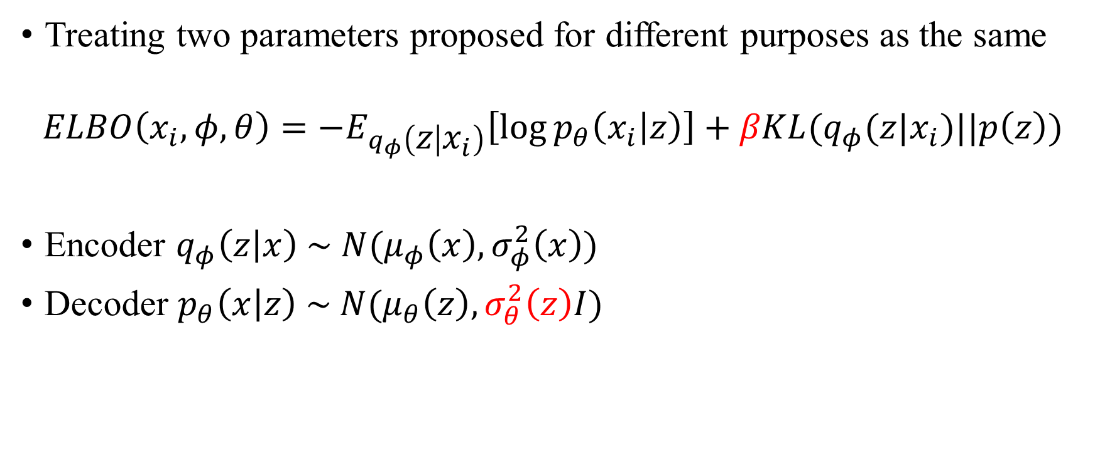
Problem
Treating two parameters proposed for different purposes as the same
$$ELBO\left(x_{i},φ,θ\right)=−E_{q_{φ}\left(z | x_{i}\right)}\left[\log{p_{θ}\left(x_{i} | z\right)}\right]+βKL(q_{φ}(z|x_{i})||p\left(z\right))$$
Encoder $q_{φ}\left(z | x\right) \sim N(μ_{φ}\left(x\right),σ_{φ}^{2}\left(x\right))$
Decoder $p_{θ}\left(x | z\right) \sim N(μ_{θ}\left(z\right),σ_{θ}^{2}\left(z\right)I)$

Slide 5
Review #07D5
Strengths of the paper
The paper presents a modification for variational autoencoders, in particular to the beta-VAE modality. The authors investigate theoretically and experimentally the role of the decoder variance, and propose a straightforward approach to resolve the ambiguity between both concepts, consisting in reintroducing ß into VAE with learnable variance decoder, named Beta-Sigma VAE (BS-VAE).
The paper is well written but accessible only to readers with a good knowledge of variational autoencoders. While it may be relevant to ICIP as the results are evaluated on two computer vision benchmarks, I think it may be more relevant to a machine learning conference, as the emphasis is more on learning than on image.
The authors compare their method against the beta-vae and show superior performance.
Weaknesses of the paper
The paper is only accessible to readers with a good knowledge of variational autoencoders. Making it accessible to a wider audience would require an extension that is not available in ICIP papers. Also, as I commented in Q1, this paper may be more relevant in other conferences more oriented to machine learning.
As I'm not en expert in VAEs, it is difficult for me to evaluate if the experimental validation is sufficient or whether there are other similar methods which should be reviewed.
Novelty/Originality/Contribution: Moderately original
Experimental Validation: Limited but convincing
Clarity of Presentation: Clear enough
Reference to Prior Work: References adequate

Slide 6
Review #1FDD
Strengths of the paper
This paper focuses on the separation of beta in the beta-VAE, in the hope of improving the quality of generated images. It's highly relevant to image processing.
Weaknesses of the paper
I have concerns over the effectiveness of working separating beta and variance of decoder.
1. This paper works on beta VAE which does not achieve the best image generation quality in today's standard. The performance baseline is obsolete. And based on Fig 2. the quality is very poor.
Is there any practical use case of separating beta?
The FID in Table 1. is not convincing enough given it is still huge. An improvement against a baseline that is far behind the current SOTA is meaningless.
Similar issues using CelebA and MNIST, these datasets are not adequate in today's standard of evaluating image generation quality.
2. It seems the technical contribution of the work is also limited, with the variance of decoder becoming learnable.
It's a marginal contribution to existing beta-VAE, which has been published in ICLR in 2017.
Novelty/Originality/Contribution: Minor originality
Experimental Validation: Lacking in some respect
Clarity of Presentation: Clear enough
Reference to Prior Work: References adequate

Slide 7
Feedback - Clarity
They did not understand the paper or misunderstood it
The problem raised is a bit vague,
So I’ve given a lengthy background in intro
This may have been the issue…

Slide 8
Feedback - Clarity
Write short and clear paragraph
Use conceptual figures actively
Explain with various examples
Describe the content in different expression

Slide 9
Feedback - Performance
Reviewers seem to value performance and practicality
I thought a lightweight model and dataset would suffice
Since it is an experiment for proof-of-concept

Slide 10
Feedback - Performance
Emphasize several times that it is for proof-of-concept
If possible, add experiments using SOTA models

Slide 11
Goal
I plan to revise the paper during the vacation
And submit it to another conference
Maybe ICPR; but it’s due next week
No changes have been made yet 🤪
I can revise the writing
But will I able to experiment with heavy SOTA models?

Slide 12
Thank you for listening
Presenter: Kim Seung Hwan (overnap@khu.ac.kr)

